Slide 1

Sample Enterprise Architecture Deliverables for a Big Data Strategy
The Disruptive Impact of Big Data
Drivers
Business Impact
Lower costs for
storage
+
• The lower cost of disk and storage allows people to keep
anything they want — and save it for later.
• Parallel-processing technologies deliver new
ways of working more cheaply with data, enabling individuals to
look anywhere for answers — more rapidly than before.
Lower costs for data
Processing
Loi de Moore
+
• It shifts the current paradigm from data processing to data
parsing, scanning and surfing.
Lower costs for
infrastructure
=
• This enables more information producers and information
consumers to create and exchange all types of content.
• Individuals can tackle new sets of problems, using tools once
restricted to a few.
More "eureka extraire l'essentiel de l'information"
moments
• Individuals generate new insights using the hypothesis, test and
explore discovery model.
• Organizations can link external data from social media sites with
internal data to gauge customer sentiment. Exemple CRM
Notes:
In our scenario, senior leaders at a global financial services firm want to know how big data can be used across the business to drive customer growth and retention. However, there is widespread confusion about the term within the organization.
Accordingly, the enterprise architecture (EA) team uses this example to educate the business and IT leaders about the drivers behind the big data phenomenon. Gartner formally defines "big data" as high-volume, high-velocity and high-variety information assets that demand cost-effective, innovative forms of information processing for enhanced insight and decision making (see "The Importance of 'Big Data': A Definition").
The EA team describes big data as representative of a new era in computing, in which the power of organizations and individuals to arbitrarily discover new or deeper insights about the world is no longer restricted by the high cost of data storage and processing.

Slide 2
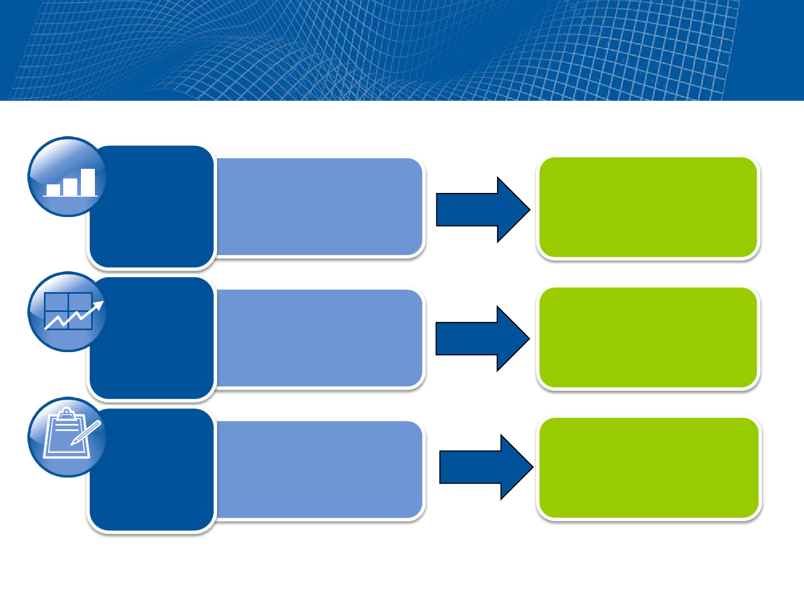
Enabling Deliverable — Understanding Current
and Future Information Requirements
Current State
Future State
• Account
• Behavior
• Transactions
• Customer
• Multichannel
• Social, mobile
Data
• Segmentation
• Risk scores
• Prediction
• Sentiment
• Simulation
• Optimization
Analytics
• Offline
development
• Scores + rules
• Embedded
• Adaptive models
Decision
Execution
Notes:
The EA team's first step is to revisit the enterprise context deliverable to jump-start the process of understanding the impact of big data on the information requirements of the enterprise (see "EA Must Include Defining Your Enterprise Context").
Here, the EA team created an enabling deliverable by updating the enterprise context to examine recent industry trends around big data. The purpose of this deliverable is to aid scoping discussions with business and IT leaders. This instrument validates known and anticipated business goals for big data, identifies additional information gaps, and begins the process of targeting and prioritizing business outcomes.
The example highlights current-state analytics focused on traditional account-level data (such as data about a specific credit card or loan), behavioral data (such as spending and payment patterns), and transactional data (such as the type of product or service purchased). Future-state information requirements for big data include harnessing external sources (including social media sites, such as Twitter feeds) and mobile platforms (for example, smartphones and tablets), which will enable customer growth and retention targets to be met.

Slide 3
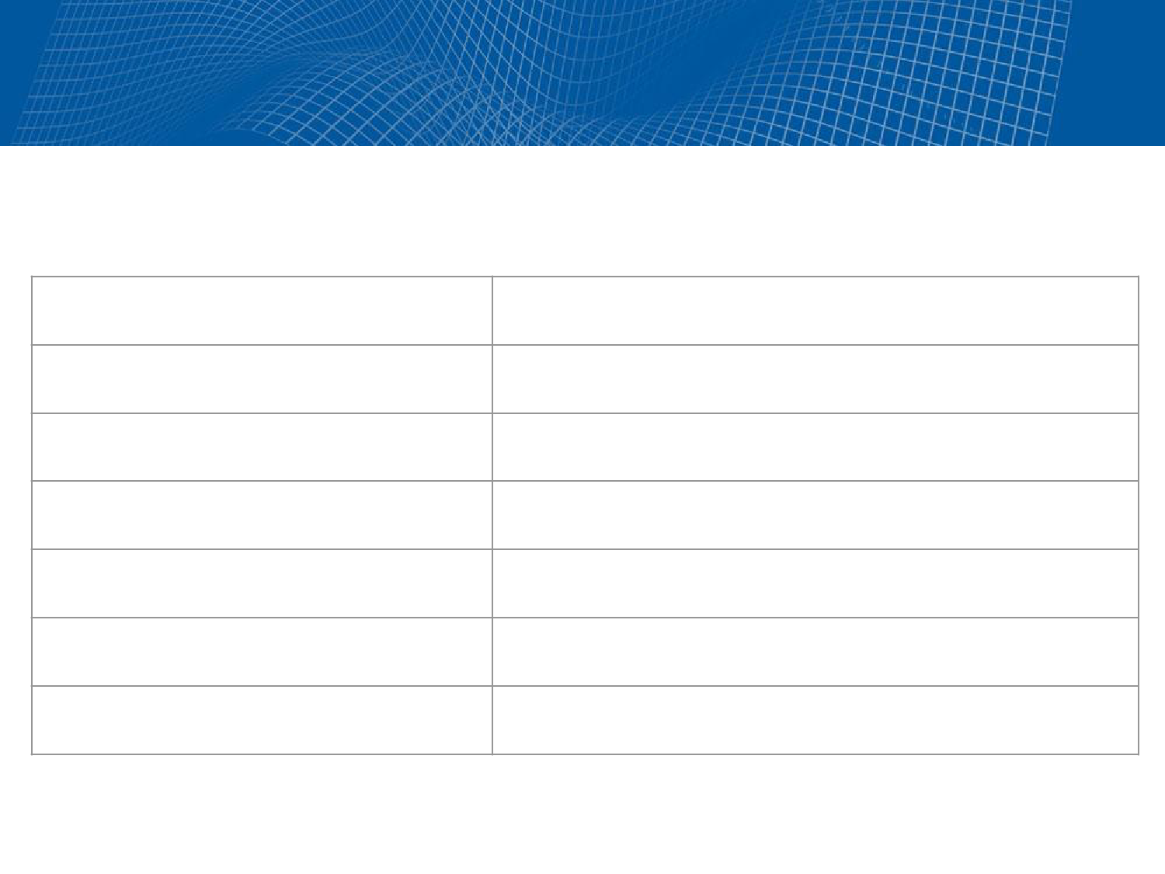
Enabling Deliverable — Focusing on the
Right Business Questions
Sample Business Questions Sample Big Data Analytics Applications
What are customers saying?
Sentiment analysis
Who are they?
Clickstream analysis and fraud detection
How do we characterize them?
Market segmentation and cluster analysis
What are they likely to do?
Churn (battre) analysis
What can we influence them on?
Buyer behavior prediction
What is changing?
Comparisons, alerts and profiling
What actions are most relevant?
Matching patterns by linking datasets
Notes:
Next, the EA team reviewed best practices from organizations already pursuing big data initiatives. The purpose was to develop a set of use cases and priorities for big data in the organization.
The result was this diagram — an enabling deliverable to illustrate sample business questions that big data answers — and the type of applications and business outcomes that big data would generate.
This enabling deliverable revealed additional skills gaps required for success with big data analytics. Specifically, while units were adept at customer segmentation profiling and analyzing churn using a specific set of sources, they lacked a shareable information architecture to link sources inside and outside the enterprise — foundational to more-advanced sentiment analysis and predictive modeling applications that exploit big datasets. Consequently, the EA team had to incorporate a maturity assessment to evaluate the analytical processes of the organization in its action plan.

Slide 4
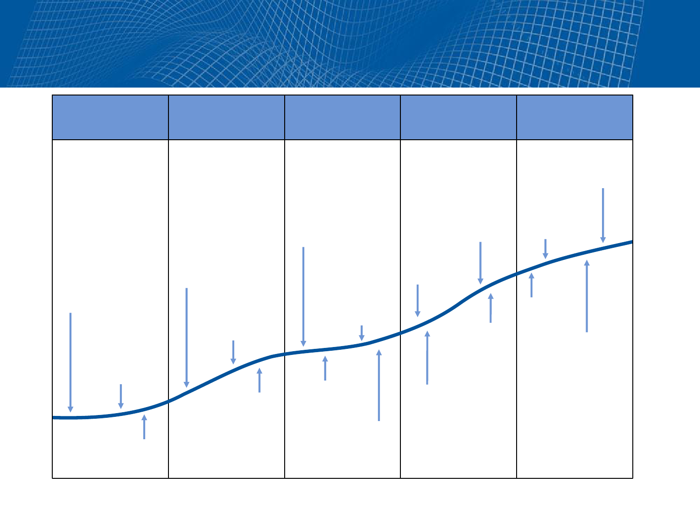
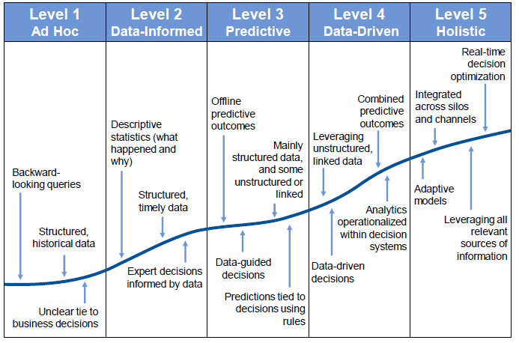
Diagnostic Deliverable — Assessing
Analytical Maturity
Notes:
The best way for enterprise architects to determine their organizations' readiness for big data is to identify skills through an analytics maturity model.
Accordingly, the EA team developed a diagnostic deliverable to more definitely gauge the analytical skills of the organization, modifying Gartner's "ITScore for Business Intelligence and Performance Management" to include a focus on big data. Data-savvy organizations embrace more-mature levels of business intelligence and performance management than traditional enterprises.
This diagnostic deliverable uncovered several barriers on the use of big data to improve customer growth and retention.

Slide 5
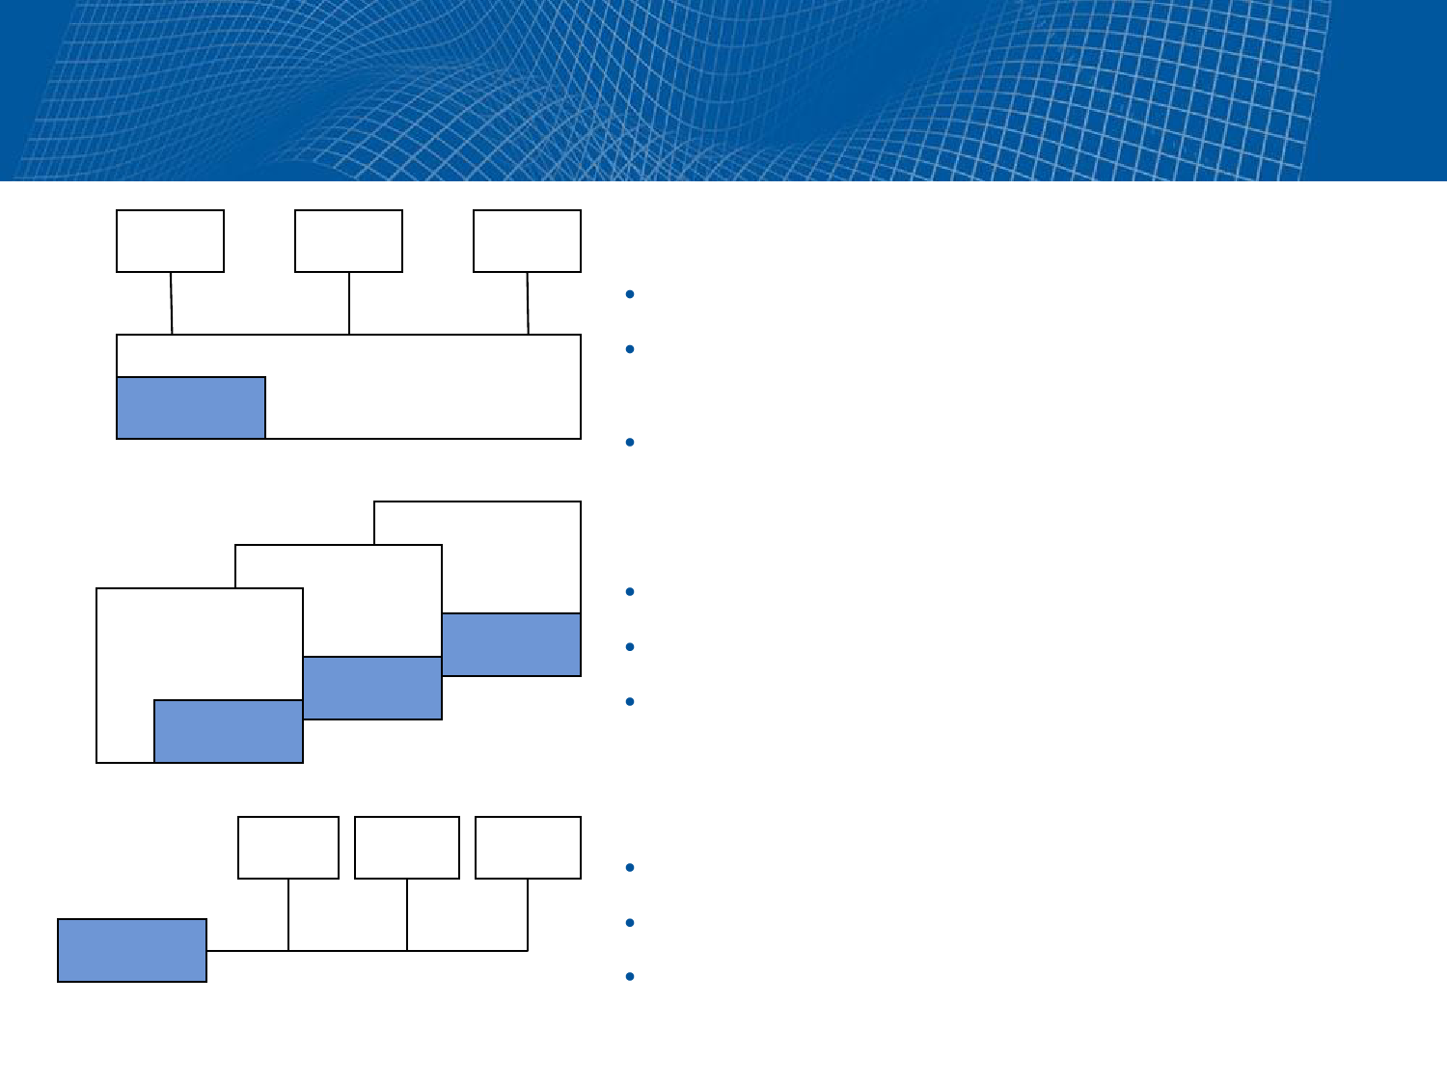
Actionable Deliverable — Comparing
Deployment Models
BU
BU
BU
Analytics as Part of IT
Strength: Close to data
Weakness: Far from business "consumers" of
the analysis
IT
Analysts
Works well for IT-centric analytics delivery
Analytics Embedded in Business Units
BU
Strength: Maximizing speed to the perceived need
BU
Analysts
Weakness: Little enterprise knowledge sharing
BU
Analysts
Works well in decentralized organizations
Analysts
Analytics Competency Center
BU
BU
BU
Strength: Maximizing analytical focus and reuse
Weakness: Meeting expectations of multiple units
Analysts
Works well for aligned and aligning organizations
Notes:
The maturity diagnostic highlighted inconsistencies in the analytical skills of different groups: Some teams were more advanced than others regarding how to use data to strengthen and improve decision making. For the leadership team, the key challenge became how the organization can best leverage the analytical talents in-house. It did not want to pursue the option advocated by some big data experts who call for hiring armies of high-priced "data scientists." Instead, the leadership team believed the organization had pockets of highly specialized and advanced analytical talent who were well-versed in the basics of data science: strong statistics and data-mining backgrounds, ability to write simple code, knowledge of the best sources to produce the best results, good data visualization skills, and a keen sense of how to follow the hypothesis, analysis and test discovery process.
To identify recommendations for moving forward, the EA team created an actionable deliverable to compare the various analytics deployment options. The proposed options were: (1) centralize all analytical functions to internal IT to gain the maximum efficiency; (2) keep analytics embedded within the various business units; or (3) create an analytics competency center to gain the maximum skills leverage. The result was a decision to deploy an analytics competency center for exploiting big data.

Slide 6
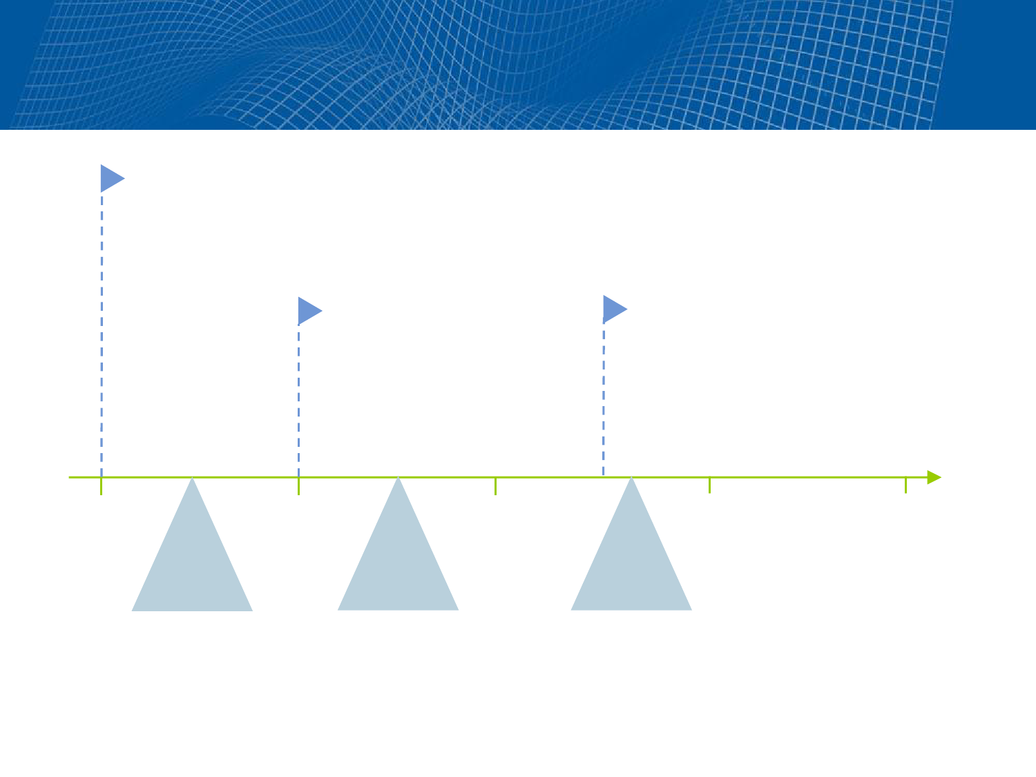
Actionable Deliverable — Target Business Outcomes
Target Business Outcomes:
• Decision-centric analysis
• Granular analysis
• Internal or external linked data sources
Target Business Outcomes:
• Big data behavioral apps
• Information-sharing
architecture
• Microsegmentation and risk
profiling
Target Business Outcomes:
• Predictive analytics
• Situational awareness apps
• Information-sharing environment
Year 1
Year 2
Year 3
Year 4
Year 5
Outcome
Outcome
Outcome
Analytics
Competency
Center
Adaptive
Enterprise
Value-Based
Networks
Notes:
The EA team created a road map — an actionable deliverable developed as a result of structured interviews with senior leaders to identify targeted business outcomes and key high-level milestones. This high-level road map enabled the EA team to work with the program management office on next-level application portfolio management functions, resource planning and the related gap closure activities.

Slide 7

Actionable Deliverable — Project Inception
Document
Big Data Analytics
Project Steps
Key Objectives
Key Participants
Frame the problem
• Is the problem a big data problem?
• Gain mutual agreement on the problem.
Business leader, IT leader, EA team, domain
expert, project manager and so on
Conduct design
analysis
• Formulate hypotheses.
• Focus on data exploration tasks.
EA team, business analyst, machine learning
expert, data mining engineer and so on
Gather data
• Work with data sources.
• Determine the relevant data.
Software engineer, network engineer, data
architect, statistician, EA team and so on
Execute and
interpret
• Ensure technical skills to execute solutions. Machine learning expert, statistician, data miner,
• Ensure business skills to interpret outcomes. EA team and so on
Implement
• Obtain technical skills to implement big data Software engineer, network engineer, data
analytics.analysts and so on
• Set up a big data analytics production
environment.
• Train users.
Measure
• Create meaningful metrics.
• Identify big data analytics successes and
failures.
Financial partner, data analyst, business analyst,
EA team and so on
Notes:
To guide teams on best practices for big data projects, the EA team produced an actionable deliverable known as a "project inception document."
This deliverable was produced by surveying industry best practices for big data projects, and modified to comply with the organization's project management methodology. This deliverable communicated to teams the various roles on big data projects and the major phases for each big data application initiative.

Slide 8

Enabling Deliverable — Assessing Big
Data's Impact on IT
Traditional BI
Analytics
Big Data Analytics
Impact
Fundamental Data Structure
Relational tables
Key-value pairs
More freedom and diversity, yet complex
parsing schemes
Gigabytes or terabytes
Terabytes and petabytes
High-performance processing
Fundamental Programming Paradigm
Declarative, SQL,
ODBC, XML
Procedural, Java, MapReduce,
open-source software
Open programming paradigm performed on
diverse data; advanced development skills
Extraction, Transformation and Loading (ETL) Development and Processing
Run as a separate
process
Integrated into the overall
pipeline (for example,
MapReduce)
Big data ETL runs on massive datasets; ETL
vendors adding Hadoop
Program Execution
Not automatically
distributed
Automatically distributed across
clusters
Easier to develop programs to process huge
datasets
Notes:
Finally, the CIO needed to understand how big data would impact internal IT. The EA team produced an enabling deliverable to guide discussions and gap planning efforts for IT teams regarding the differences between big data technologies and traditional technologies for analytics.
This led to an impact assessment to determine the change management issues of big data on the IT organization (see "Big Data Disruptions Tamed With Enterprise Architecture").

